Slide 1









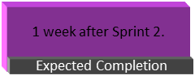
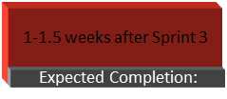
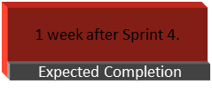
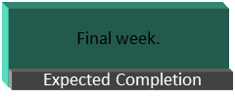
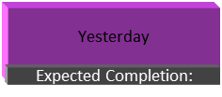
Project ROADMAP
VALID8
PROJECT
Sprint 1
Sprint 2
Sprint 3
Sprint 4
Sprint 5
Sprint 6
Status: Done
Status: On-going
Status: Upcoming
Status: Upcoming
Status: Upcoming
Status: Upcoming
Title: Project Planning & Setup
Title: User Authentication & Role Management
Title: Event Management & Attendance Tracking
Title: Face Recognition & AppSheet Integration
Title: Admin Dashboard & Reports
Test cross-platform (mobile, desktop, AppSheet) functionality.
No changes needed.
Prioritize API security testing (JWT/session handling, SQL injection prevention)
Make sure attendance logs are exportable as CSV/PDF.
Comment
Verify AppSheet authentication logic
Optimize database queries for speed (avoid slow queries)

